Slide 1
Simple Harmonic Motion
MS864M

Slide 2
Harmonic motion
A motion which repeats in equal intervals of time is termed as a periodic motion.
If the periodic motion occurs back and forth over the same path, then it is termed oscillatory or harmonic.
Examples of oscillatory or harmonic motions include the spring-mass system and the simple pendulum.
Vertical spring mass animation

Slide 3
Important terms in periodic motion
Amplitude, A – maximum displacement from the equilibrium position. The SI unit is metre.
Period, T – Time taken to complete one oscillation or cycle. The SI unit is second.
Frequency, f – Number of oscillations or cycles in a unit of time. The SI unit is hertz (Hz) or cycle/s.
Angular frequency (ω) – Angular displacement per second. Its unit is rad/s.

Slide 4
Example 1
An ultrasonic transducer (a kind of loudspeaker) used for medical diagnosis oscillates at a frequency of 6.7 MHz. How much time does each oscillation take and what is the angular frequency?

Slide 5
Simple harmonic motion (SHM)
Simple harmonic motion is a kind of oscillation where the force acting on the object is directly proportional to the displacement of the object from its equilibrium position, i.e. F = – kx
where k is a constant.
The negative sign indicates that the direction of F and the displacement x are opposite.
F is called the restoring force as it restores the object to its equilibrium position.

Slide 6
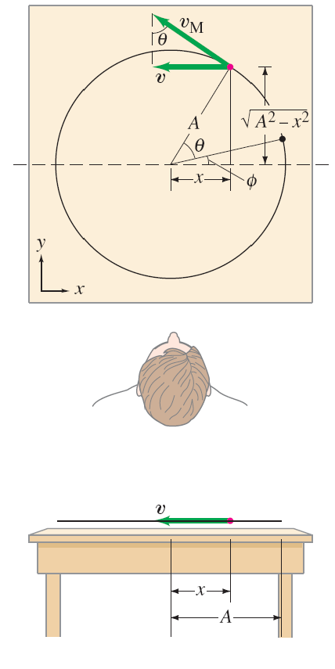
SHM and circular motion
In many systems the restoring force is approximately proportional to the displacement if the displacement is small.
SHM is related to circular motion.
If we look at the projection onto the x or y axis of an object moving in a circle at a constant speed, we find that the x or y component of its position is the same as SHM.

Slide 7
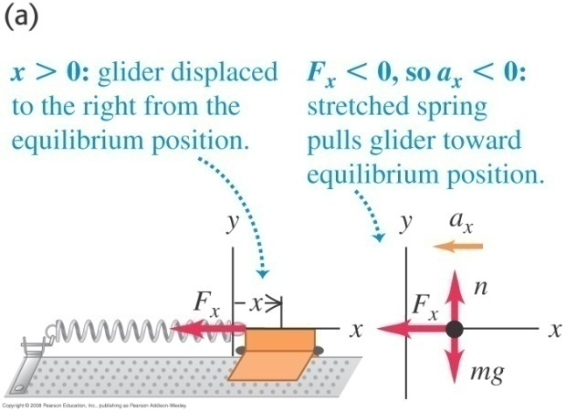
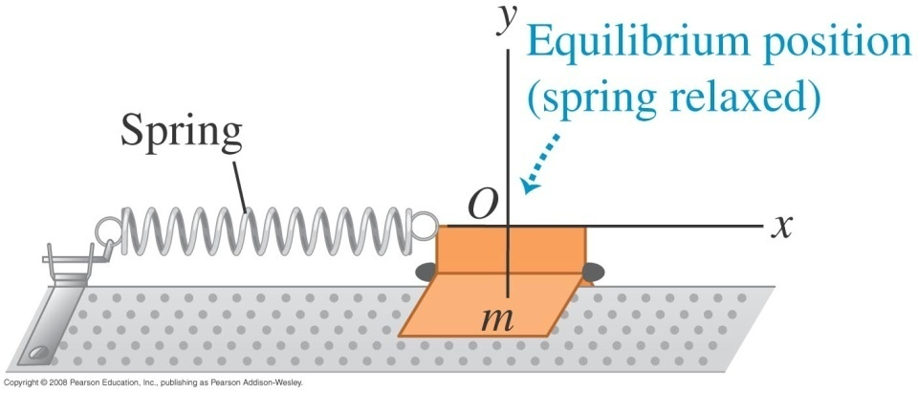
Spring-mass system – an example of SHM
A spring-mass system comprises a mass m, attached to a light spring, on a frictionless horizontal guide.
If the spring (of spring constant k) is stretched or compressed from its equilibrium position O, a net force, F = –kx is exerted by the spring on the mass to bring it back to O.
Animation

Slide 8
Spring-mass system – an example of SHM
For a spring-mass system without damping forces, Newton’s second law state
The acceleration a of the mass is not constant as it depends on x.

Slide 9
The angular frequency
ω is the angular frequency and is determined by the spring constant k and the mass of the object m.
ω is related to frequency and time period as
Note that for SHM, the period or frequency is independent of the amplitude.

Slide 10
The phase angle
The phase angle ϕ tells us at what point in the cycle the motion was at t = 0.
We can also use the sine function instead of cosine for the displacement using the identity

Slide 11
Solution of the differential equation
The solution of the differential equation
is , where A is the amplitude and ϕ is the phase angle.
Since the values of the cosine function lie between –1 to 1, the displacement x varies between –A to A.
To show that is the solution, we differentiate it twice, i.e.

Slide 12
Velocity and acceleration in SHM
The velocity for a simple harmonic oscillator can be obtained as
The velocity varies between –ωA and +ωA.
The acceleration for a simple harmonic oscillator can be obtained as
The acceleration varies between –ω²A and +ω²A.

Slide 13
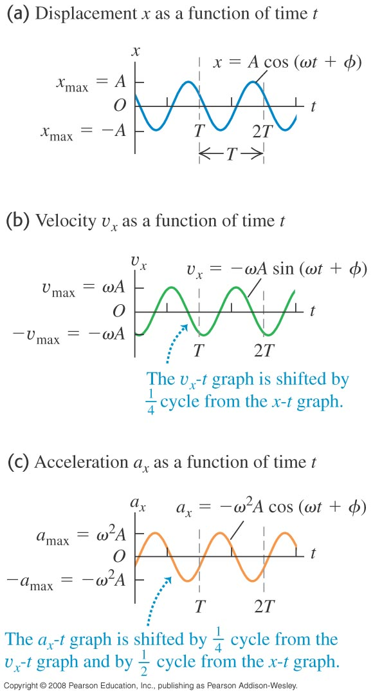
Graphs of displacement, velocity and acceleration
The velocity-time graph is repeated on the right for ease of comparison.

Slide 14
Determining the amplitude and phase angle
From and , at t = 0 ,

Slide 15
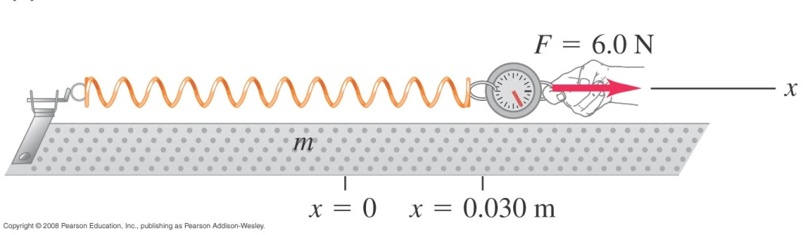
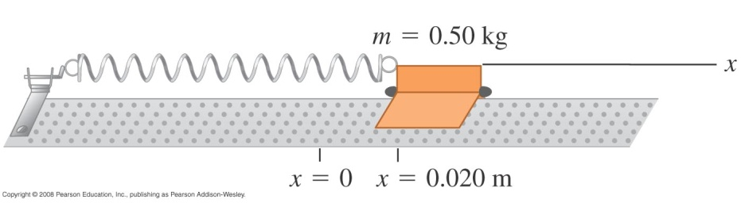
Example 2
A spring is mounted horizontally with its left end stationary. By attaching a spring balance to the free end and pulling toward the right we determine that the stretching force is proportional to the displacement and that a force of 6.0 N causes a displacement of 0.030 m.
Then the spring balance is replaced by a 0.50-kg glider which is pulled through a distance of 0.020 m along a frictionless air track and released. Find the force constant, angular frequency, frequency and period of oscillation
Notes:
k = 200 N/m, ω = 20 rad/s, f = 3.2 Hz, T = 0.31 s

Slide 16
Example 3
Referring to example 2 with force constant = 200 N/m and mass 0.50 kg, if we give the body an initial displacement of +0.015 m and velocity of +0.40 m/s,
a) Find the period, amplitude and phase angle of the motion.
b) Write the equations for the displacement, velocity and acceleration as functions of time.
Notes:
T = 0.31s, A = 0.025 m, phase angle = –53º = –0.93 rad
x = (0.025 m) cos [ (20 rad/s) t – 0.93 rad]
v_{x} = – (0.5 m/s) sin [ (20 rad/s) t – 0.93 rad]
a_{x} = – (10 m/s²) cos [ (20 rad/s) t – 0.93 rad]

Slide 17
Total mechanical energy of a spring-mass system
Neglecting the mass of the spring, the total mechanical energy consists of the kinetic energy (K) of the object and the potential energy (U) of the spring, i.e.
The total mechanical energy is conserved (constant throughout the motion) as the force exerted by the spring is conservative.

Slide 18
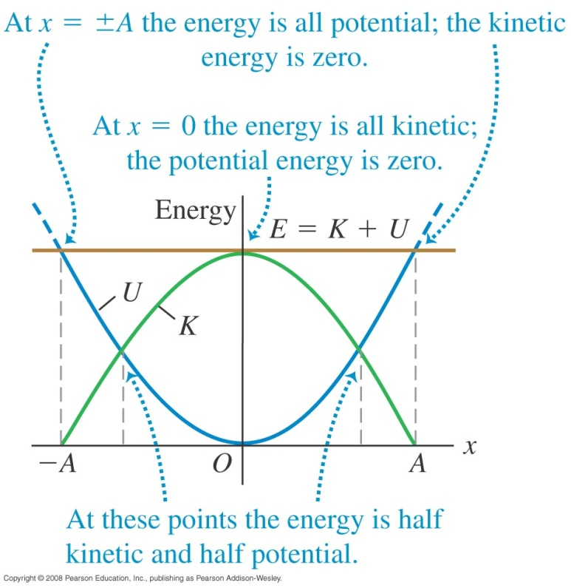
Total mechanical energy of a spring-mass system
The below figure shows the potential energy (U) and kinetic energy (K) as function of position x for SHM.

Slide 19
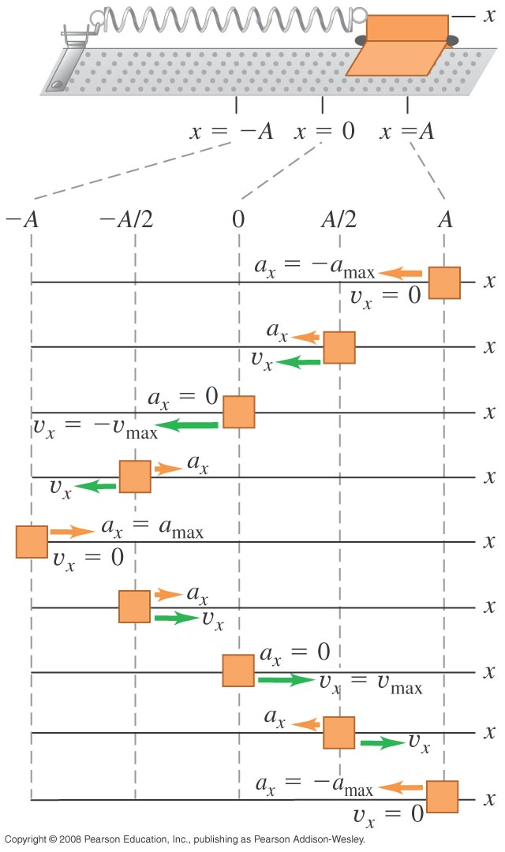
Total mechanical energy of a spring-mass system
The energy equation can be used to calculate the object velocity at a given displacement, viz:
The maximum velocity occurs at x = 0, i.e.
At x = A (amplitude), the velocity is is zero.

Slide 20
Example 4
Referring to example 2 where k = 200 N/m, m = 0.50 kg and the oscillating mass is released from rest at x = 0.020 m.
a) Find the maximum and minimum speed attained by oscillating body.
b) Find the maximum acceleration.
c) Determine the velocity and acceleration when the body has moved halfway to the centre from its original position.

Slide 21
Example 4 - cont

Slide 22
The simple pendulum – another SHM
A simple pendulum consists of a point mass suspended by a massless un-stretchable string.
If the point mass is displaced from equilibrium position, oscillations take place.
The restoring force is provided by the component of the weight of the mass.
The path of the point mass (also known as the pendulum bob) is an arc of circle with radius L which is the length of the string. See animation

Slide 23
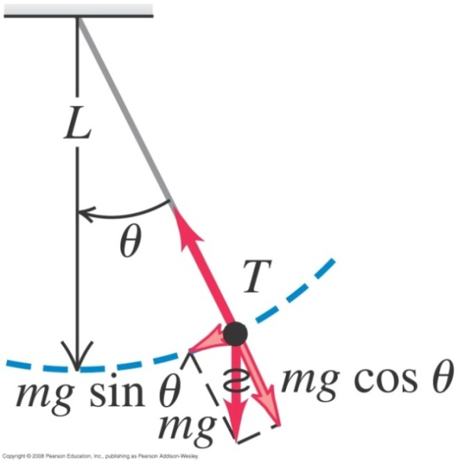
The simple pendulum
From the figure, the restoring force is F = –mg sin θ.
From Newton’s second law,

Slide 24
The simple pendulum
The frequency and time period of a simple pendulum are
The frequency and period depend only on the length of the string L and acceleration due to gravity g.
Note that the above analysis is applicable only when the displacement and hence the amplitude is small.

Slide 25
Example 5
Find the period and frequency of a simple pendulum 1.000 m long at a location where acceleration due to gravity is 9.800 m/s².
Notes:
T = 2.007 s, f = 0.4983 Hz

Slide 26
Self study slides

Slide 27
Damped oscillations
In the real world, dissipative forces cause a decrease in the amplitude of an oscillatory system.
The simplest case is F = -bv, where b describes the strength of damping which occur in friction involving viscous fluid flow, and v is velocity.
The net force on the body is
Damping animation

Slide 28
Small damping
Solving the differential equation, we get expressions is for an oscillator with small damping also known as under damping.
The angular frequency ω’ is smaller than ω in the no damping case.
The amplitude is not a constant and decreases according to .

Slide 29
Critical damping
When the damping is increased further, a point is reached when ω‘ becomes zero, i.e.
The system is said to be critically damped and there is no oscillations.
The mass returns to its equilibrium position when it is displaced and released.
Damping animation

Slide 30
Overdamping
If , ω’ is complex and the system is over damped.
There is no oscillation and the system returns to equilibrium more slowly than in the critical damping case.
The solution of the differential equation for overdamp case is
where C₁ and C₂ depend on the initial conditions while a₁ and a₂ are determined by m, k and b.

Slide 31
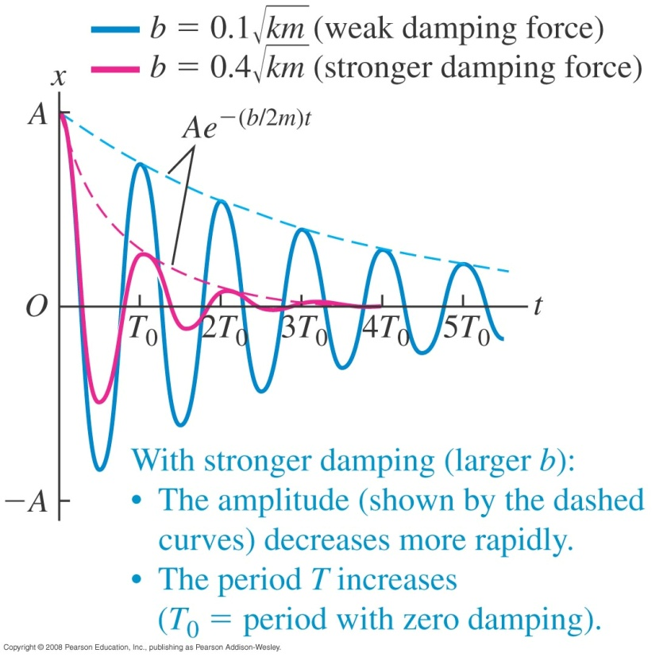
Graphs of displacement in damped oscillation

Slide 32
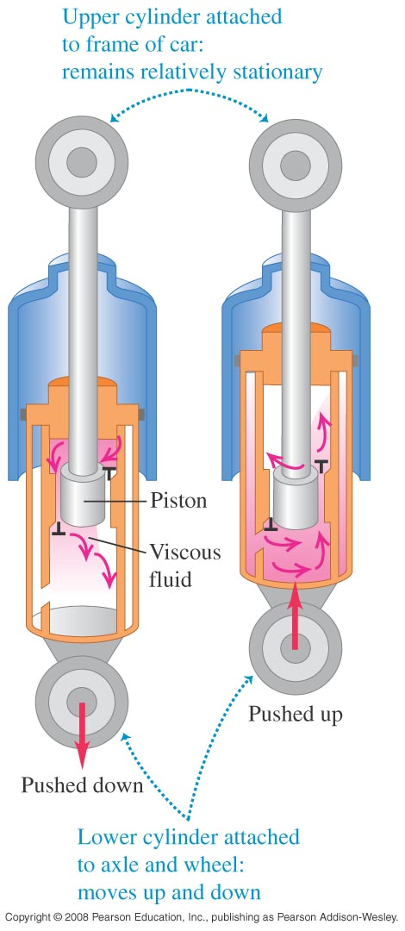
Uses of damping
One use of damping is in an automobile’s suspension system.
The shock absorbers provide a velocity dependent damping force so that when a car goes over a bump, it does not continue bouncing forever.
For optimal passenger comfort, the system should be critically damped or slightly under damped.

Slide 33
Energy in damped oscillations
For a spring-mass system with damping

Slide 34
Forced oscillations
Periodically applying a driving force with angular frequency (ω_{d}) to a damped harmonic oscillator results in a forced or driven oscillation.
The mass oscillates with angular frequency ω_{d} which may or may not be equal to the system’s natural angular frequency ω’.
The oscillation amplitude is a function of the driving frequency ω_{d}.

Slide 35
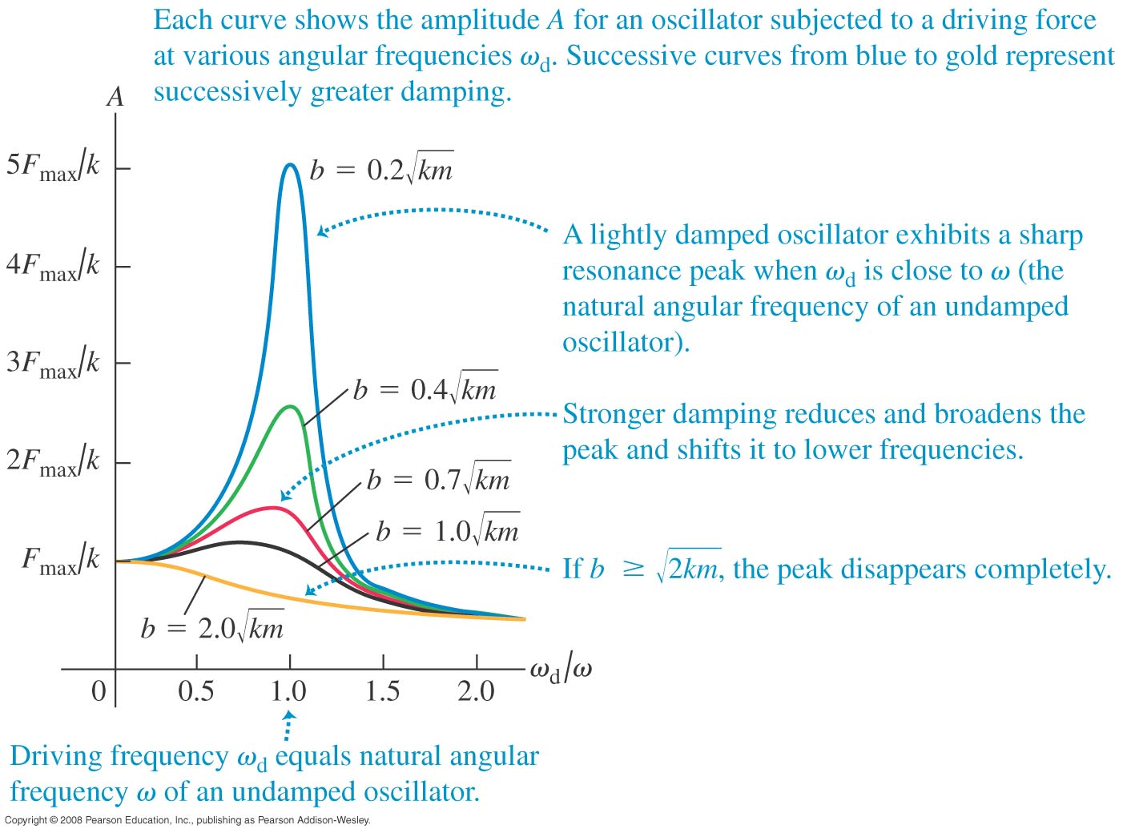
Amplitude at resonance
An example of resonance is the building up of oscillations of a child on a swing by pushing it with a frequency equal to the swing’s natural frequency.
Resonance of wine glass

Slide 36
End of chapter

